Slide 1
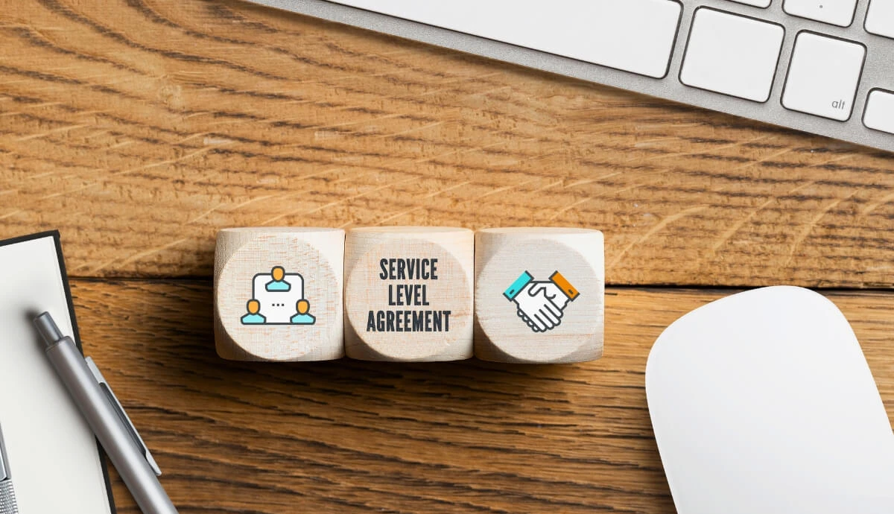
Lec 6
Sla Contd

Slide 2
Types of SLA
Service Level SLA
Customer Level SLA
Multilevel Service Level Agreement

Slide 3
Service Level SLA
This SLA is centered around a particular service that is the same for all customers, describing the service level expectations.
Example: A cloud provider guarantees 99.9% uptime for its virtual machines.

Slide 4
Customer Level SLA
This type of SLA is tailored to a specific customer or group of customers and outlines all the services agreed upon by the provider and the customer
Example: A managed IT service provider commits to resolving high-priority issues for a corporate client within 4 hours.

Slide 5
Multilevel Service Level Agreement
A hierarchical SLA structure that applies at different levels within an organization.
This type of SLA is divided into levels, often addressing multiple aspects such as corporate, customer, and service levels to cater to various needs within an organization.

Slide 6
SLA Example
Say we are a beverages provider, with tea, coffee, and juices in our service portfolio
If customer A wants the tea to be provided every morning and evening, coffee before and after lunch, and juices during lunch hours, that’s the customer-specific SLA we have signed with that particular customer, and that’s how we price the offering
Customer-Based SLA is tailored and personalized, often at a premium price.

Slide 7
SLA Example …
On the other hand, if we also have a stand where we offer juices throughout the day but at fixed prices and where customers B and C can source their needs, this is a service-based SLA
Service-Based SLA offers a standardized service with the same terms for all customers.

Slide 8
5 Things to Look For in a Cloud Service Level Agreement
Availability
Data ownership
Cloud hardware and software
Disaster recovery and backup
Customer responsibilities

Slide 9
Availability
The biggest quality-of-service (QoS) concept that should be covered in any Cloud SLA is the provider’s promised availability
Providers might break down availability depending on time frame
– for example, they might promise 99.99% availability during business hours
These terms should also include the provider’s plan for unexpected downtime, including alerting its users and providing updates on maintenance and service repairs.

Slide 10
Data ownership
Who owns your data in the cloud?
That question prevents many enterprises from making the jump to the cloud, especially when they consider sensitive data
An SLA should specifically outline its data ownership policies so that everything is transparent and clear
Ideally, an SLA should state that all ownership rights stick with the user
However, if the provider doesn’t explicitly state its data ownership policies in the SLA, you can’t guarantee the safety of your information.

Slide 11
Cloud hardware and software
Your cloud provider requires the use of hardware and (potentially) software to operate its services
The provider should outline the hardware that the cloud services rely on, including servers and other devices
Knowing your cloud’s equipment and software specifications will help you understand the specifics behind your cloud environment’s construction and what you’ll need to educate your staff on

Slide 12
Disaster recovery and backup
In the event of a disaster, your cloud provider should have a plan in place to prevent total loss of your data
Cloud providers should have a section of the SLA that describes their disaster recovery and backup solutions in detail
Depending on the provider, they may provide automatic backups and snapshots of your data
If the user is required to set up backup and recovery systems, the SLA should outline that
It may not specifically state how to activate them, but you should be aware if you need to activate them or not.

Slide 13
Customer responsibilities
The SLA is a contract that outlines responsibilities that both the provider and customer agree to
Your cloud provider needs to inform you of what you’re liable for when you enter the agreement
Make sure you consider over the entirety of the SLA to know what your provider will manage and what you need to as a customer

Slide 14
How often should we revise our SLAs?
Most SLAs are negotiated to meet the customer's current needs, but many businesses change dramatically in size over time
A solid cloud service-level agreement outlines intervals where the contract is reviewed and potentially adjusted to meet an organization's changing needs.
Some vendors build in notification workflows that trigger when a cloud service-level agreement is close to being breached, so new negotiations can be initiated based on the changes in scale. This can cover uptime availability levels or usage that exceeds criteria and might warrant an upgrade to a new service tier

Slide 15
Cloud SLA examples
SLA summary for AWS
https://aws.amazon.com/legal/service-level-agreements/
SLA summary for Azure services
https://azure.microsoft.com/en-us/support/legal/sla/summary/
SLA summary for Google Cloud
https://cloud.google.com/terms/sla

Slide 16
Few questions to ponder
How does an SLI help measure system performance?
How do SLIs relate to SLOs?
How does an SLA differ from an SLO?
What happens if an SLA is breached?
Can an SLO exist without an SLA? Why or why not?
What are some common SLIs in a web service?
How do you calculate an SLI for system uptime?
Why is it important to set realistic SLOs?
Who defines the terms of an SLA?
What role do SLIs play in monitoring system health?
How can SLAs impact customer satisfaction?
What tools can be used to track SLIs?

Slide 17
Enabling Desktop , RDP on Linux LTS Server
First update system
sudo apt-get update
Then install UI XFCE4
sudo apt-get install xfce4
Afterwards install XRDP - remote desktop
sudo apt-get install xrdp
Then register xrdp in xfce4
echo xfce4-session ＞ ~/.xsession
Finally restart XRDP
sudo service xrdp restart

Slide 18
OR
sudo apt install ubuntu-desktop –y (Latest GUI)
sudo apt-get -y install xrdp (Install Remote Desktop)
sudo systemctl enable xrdp (Enable Remote Desktop)

